Slide 1
A deeper dive into dev containers for your project

Slide 2
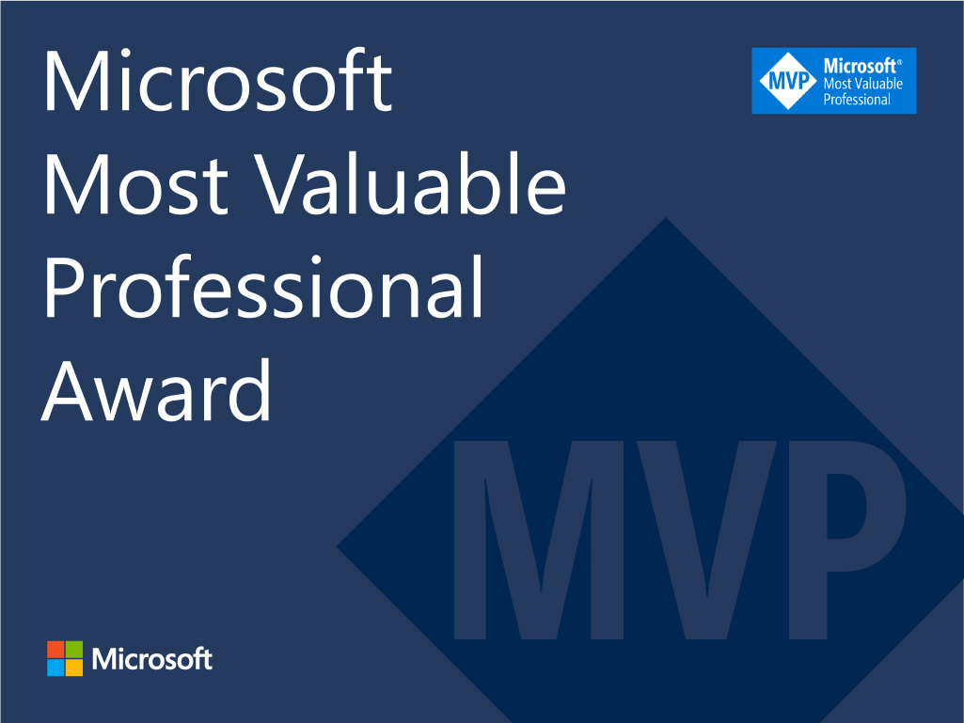





Jess Pomfret
She/Her
Passionate about
Automation
Proper Football
Fitness
Database Platform Architect Data Masterminds
beard.media/book dbatools dbachecks PowerShell & Data Community
/jpomfret
@jpomfret
jesspomfret.com

Slide 3

Rob Sewell
He/Him
Bearded Consultant
Automator
Trainer
Consultant Sewells Consulting Ltd
beard.media/book dbachecks PowerShell & Data Community
/robsewellsqldba
@sqldbawithbeard
blog.robsewell.com

Slide 4

Notes:
We are not a couple, we have our own wifes

Slide 5

Register Now events.sqlbits.com/2023
Register Now events.sqlbits.com/2023
Submit Sessions
sessionize.com/sqlbits-2023 sessionize.com/sqlbits-trainingdays2023
Volunteer beard.media/sqlbits-helpers

Slide 6

Why?
Photo by Eric Welch on Unsplash

Slide 7

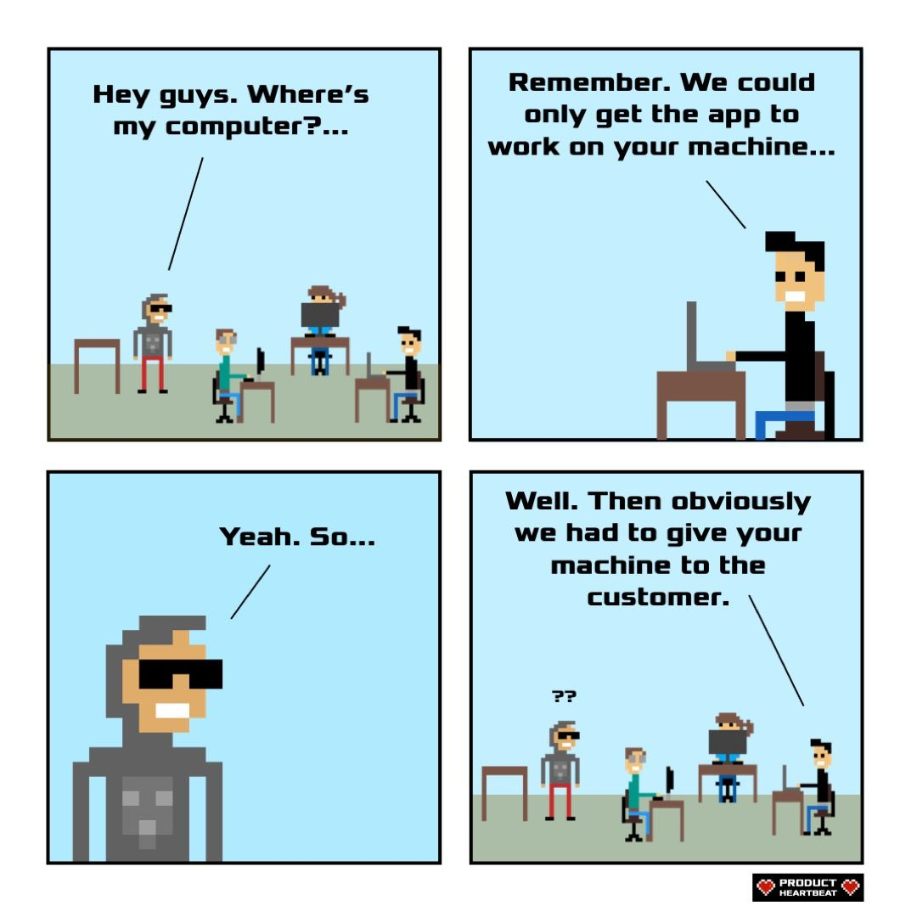
Product Heartbeat - Comics - Works on my machine
Photo by Rebecca Prest on Unsplash

Slide 8
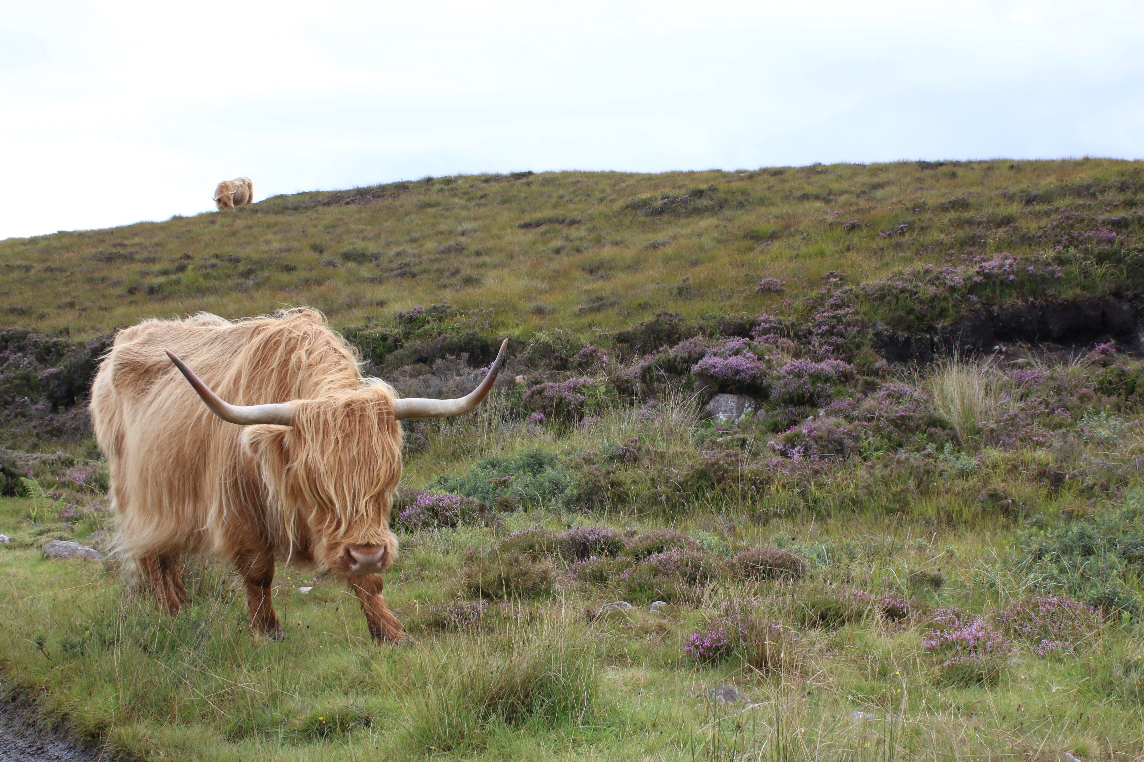
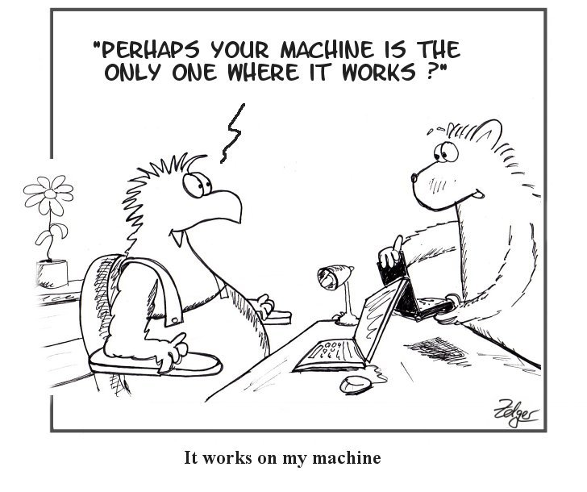
Simply the Test: IWOMM - It Works on My Machine (simply-the-test.blogspot.com)
Photo by Marta Smith on Unsplash

Slide 9

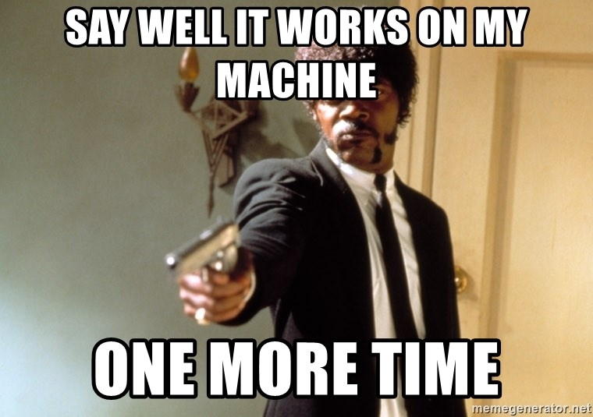
Photo by Frank Busch on Unsplash

Slide 10
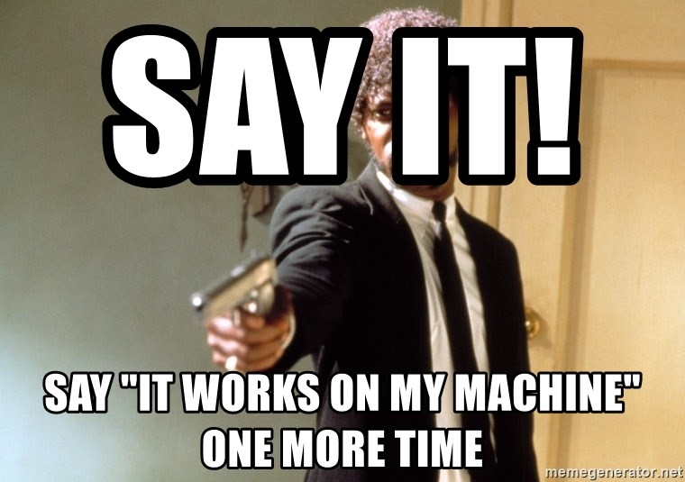
Photo by Frank Busch on Unsplash

Slide 11
Photo by Frank Busch on Unsplash

Slide 12

Identical
So that everyone is able to have the same experience and able to concentrate on developing rather than setting up.
Photo by Jan Antonin Kolar on Unsplash
Notes:
Rob
Want the same environment for everyone and both of us without issues under our control
- Having the same extensions for example – Jess had Git graph and Rob didnt

Slide 13
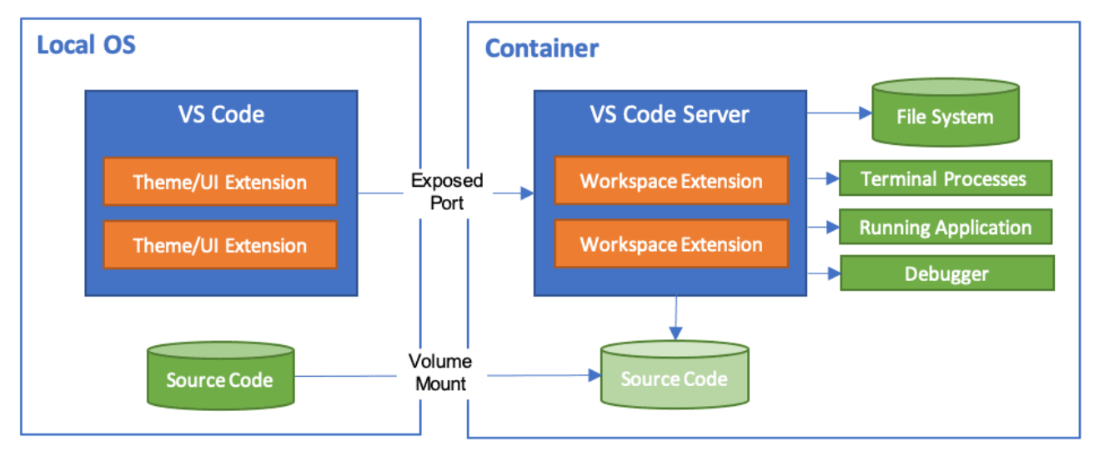

Dev Container
code.visualstudio.com/docs/remote/containers
Notes:
Jess
Run VSCode locally and connect to
a docker container as a remote server
Setup the environment as code – then it can be used by anyone
Include vs extensions
Mount source code folder into container
Can install things inside the container that you need – and not have to install on your desktop
We have options for how we setup dev container
Could use ‘post create command’ in devcontainer.json
Or could bake it into the container image and build the devcontainer from that image

Slide 14
Dev Container
code.visualstudio.com/docs/remote/containers
Notes:
Jess
Run VSCode locally and connect to
a docker container as a remote server
Setup the environment as code – then it can be used by anyone
Include vs extensions
Configuration as code
Mount source code folder into container
Can install things inside the container that you need – and not have to install on your desktop
We have options for how we setup dev container
Could use ‘post create command’ in devcontainer.json
Or could bake it into the container image and build the devcontainer from that image

Slide 15
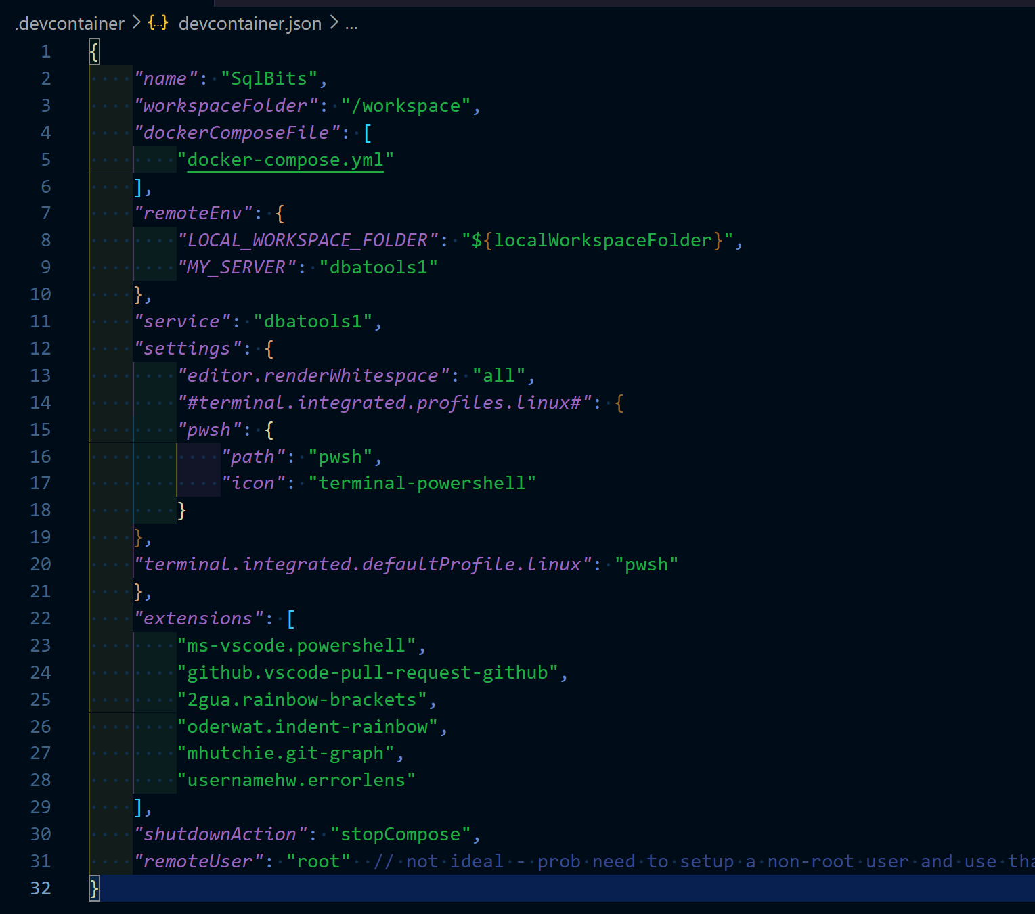
devcontainer.json
Notes:
Jess
Just add a devcontainer.json and set it up how you want your environment to be
Anybody that opens the repo in VsCode – it’ll see this devcontainer.json file and prompt you to open in container – we’ll point that out in the demo
Workspace folder – where it’ll end up
Service – is where we want to go - ‘the service you want to work on’
Extensions –

Slide 16
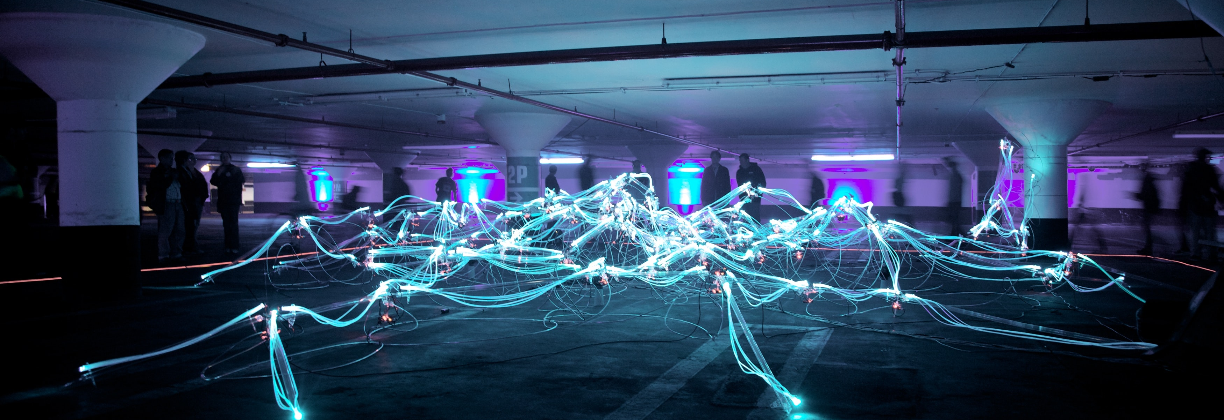
Updating
Photo by Marius Masalar on Unsplash
Notes:
Rob - We are not animals

Slide 17
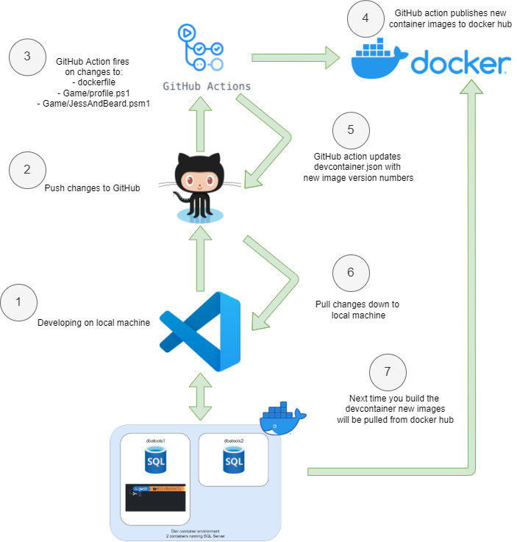
Development Workflow
Notes:
Jess
Docker image tags
Then the devcontainer will notice the configurations changed and when we rebuild it’ll pull new images

Slide 18
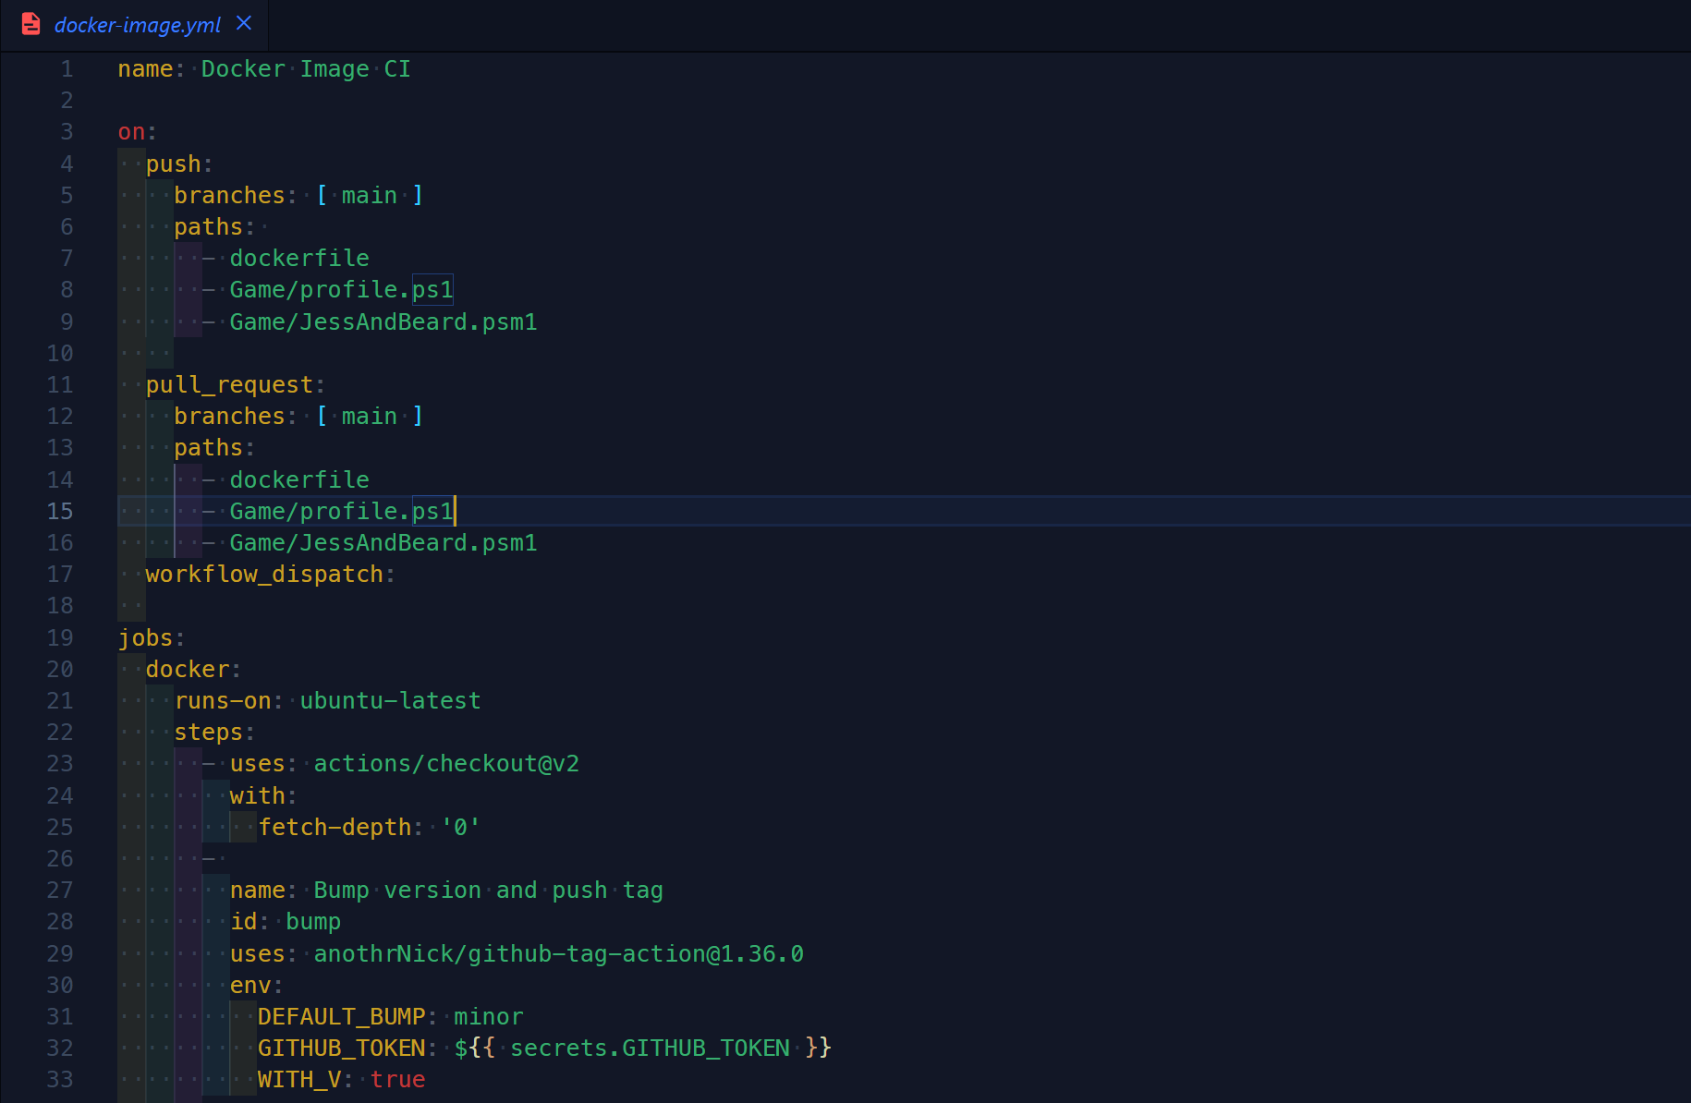
GitHub workflow
Notes:
Jess
On push paths – certain files that meant we wanted to rebuild container
Workflow_dispatch – so we can run it manually
Bump version

Slide 19
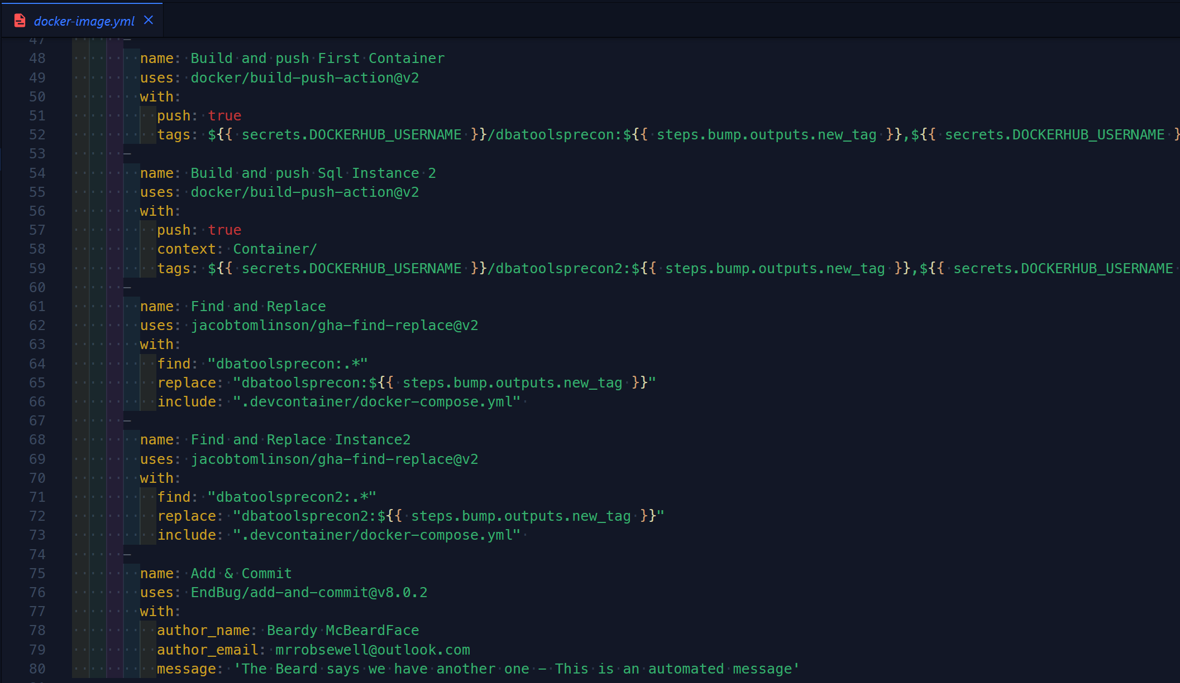
GitHub workflow
Notes:
Jess
Github secrets – following best practices not to store credentials in our repo
Build-push-action – pushes containers to docker repo
Find & replace – 2 steps – couldn’t be bothered with the regex
Add & commit

Slide 20


